Slide 1
R Shiny for Operations and GIS
Instructor: Geoffrey Arnold

Slide 2
Course Details

Slide 3
Class Logistics
There is no required text for this course, but supplemental websites and materials will be provided
There will 2 graded projects and 3 homework assignments
The lowest homework grade will be dropped
Each student will be required to submit their own code for assignments but working with a partner or group is encouraged.
Assignments will be due on Friday at Midnight

Slide 4
TA Info

Slide 5
About the Instructor
Education:
University of Pittsburgh: BA Political Science & History 2010
Heinz College: MS PPM 2015
Professional:
PA State Democratic Party: Field Organizer 2010
City Year Greater Philadelphia: Senior Corps Leader: 2011-2012
Lutheran Child & Family Services: Group Leader 2013
City of Pittsburgh: Performance Improvement Analyst 2015-2017

Slide 6
Basic Concepts of Shiny apps
They’re all just functions

Slide 7

Three Basic Parts of the function
UI – User Interface
Builds the webpage
Can be done in R code OR HTML
Server
Generates all reactive content
Can be used to change portions of UI
Session
Used for generating messages to users
Creating bookmark URL’s

Slide 8
Basic Concepts of Shiny apps
Building a User Interface

Slide 9
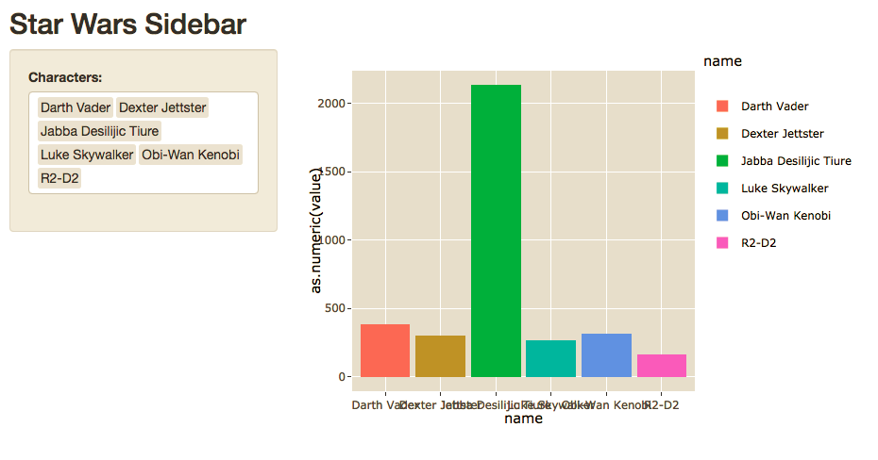
Sidebar Layout

Slide 10
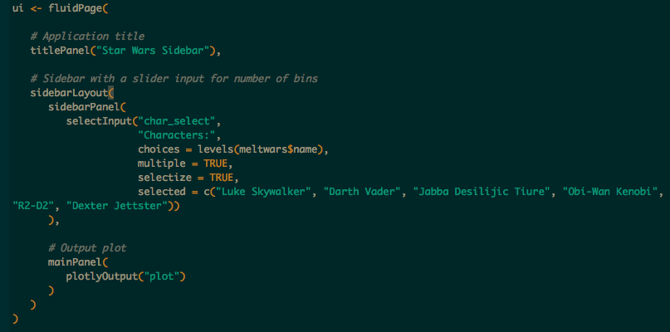

Slide 11
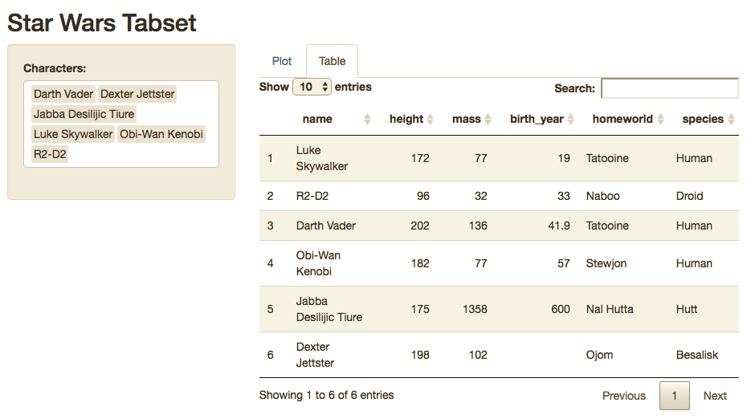
Sidebar w/ Tabset

Slide 12
